Slide 1

Introduction to Algorithms
Lecture 1:Dynamic Connectivity Problem
Yao-Chung Fan
yfan@nchu.edu.tw
Notes:
[wayne s14] I always seem to run over. Consider cutting percolation.
[wayne s14] modified terminology to use connected (instead of find)
[wayne s12] weighted quick union and quick union not identical when two trees have same size. Suggest changing quick union to break ties differently since the demos for weighted quick union would require more work to fix.

Slide 2
The Goal of This Course…
Steps to developing a usable algorithm.
Model the problem.
Find an algorithm to solve it.
Fast enough? Fits in memory?
If not, figure out why not.
Find a way to address the problem.
Iterate until satisfied.

Slide 3
Union-Find Algorithm
dynamic connectivity problem
quick find
quick union
improvements

Slide 4



A connectivity example
Q. Is there a path connecting p and q ?
A. Yes.
p
q
Notes:
more difficult problem: find the path. We will revisit this problem in the second half of the course. But dynamic solutions that don't need to find the path are more efficient.
medium.txt (625 sites, 900 edges, 3 connected components)

Slide 5
Dynamic connectivity problem
Given a set of N objects, support two operations:
Connect two objects.
Is there a path connecting the two objects?
connect 4 and 3
connect 3 and 8
connect 6 and 5
0
1
2
3
4
connect 9 and 4
connect 2 and 1
𐄂
5
6
7
8
9
are 0 and 7 connected?
are 8 and 9 connected?
✔
connect 5 and 0
connect 7 and 2
connect 6 and 1
connect 1 and 0
are 0 and 7 connected?
✔
Notes:
find() returns the component id, but we won't use that method is this lecture for brevity

Slide 6
Modeling the objects
Applications involve manipulating objects of all types.
Computers in a network.
Friends in a social network.
Transistors in a computer chip.
Virus Diffusion in a social network
Notes:
Manhattan sewers, McCosh rooms

Slide 7
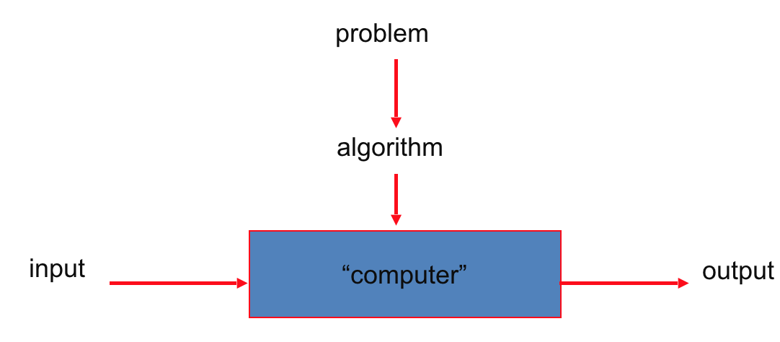
Before we are going down, Let’s think about how we deal with such a problem ?
Data Structure ?
Algorithm ?

Slide 8
Union-Find Algorithm
dynamic connectivity
quick find
quick union
improvements

Slide 9
Implementing the operations
Find. In which set is object p ?
Connected. Are objects p and q in the same set?
Union. Replace components containing objects p and q with their union.
0
1
2
3
0
1
2
3
union(2, 5)
4
5
6
7
4
5
6
7
{ 0 } { 1 4 5 } { 2 3 6 7 }
{ 0 } { 1 2 3 4 5 6 7 }
3 sets
2 sets

Slide 10
Union-find data type (API)
Goal. Design efficient data structure for union-find.
Number of objects N can be huge.
Number of operations M can be huge.
Union and find operations may be intermixed.
public class UF
 | UF(int N) | initialize union-find data structure with N singleton objects (0 to N – 1)
void | union(int p, int q) | add connection between p and q
boolean | connected(int p, int q) | are p and q in the same component?

Slide 11
Data Structure ?
Concept Set
0
1
2
3
4
5
6
7
{ 0 } { 1 4 5 } { 2 3 6 7 }
3 sets
Notes:
Simple model captures the essential nature of connectivity.
equivalence relation partitions objects into equivalence classes = connected components = sets of integers

Slide 12
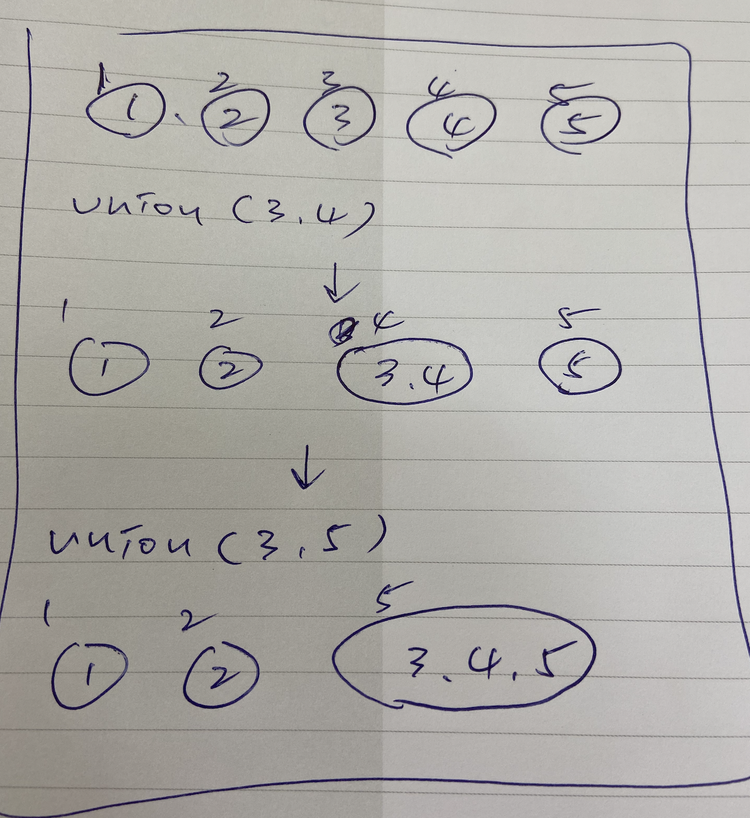
basic idea
Use an id information to record the connectivity of two objects

Slide 13
Union-find data type (API)
Goal. Design efficient data structure for union-find.
Number of objects N can be huge.
Number of operations M can be huge.
Union and find operations may be intermixed.
public class UF
 | UF(int N) | initialize union-find data structure with N singleton objects (0 to N – 1)
void | union(int p, int q) | add connection between p and q
int | find(int p) | component identifier for p (0 to N – 1)
boolean | connected(int p, int q) | are p and q in the same component?
public boolean connected(int p, int q)
{ return find(p) == find(q); }
1-line implementation of connected()

Slide 14
Quick-find: Java implementation
public class QuickFindUF { private int[] id;
public QuickFindUF(int N)
{
id = new int[N]; for (int i = 0; i < N; i++) id[i] = i;
}
public int find(int p) { return id[p]; }
public void union(int p, int q) { int pid = id[p]; int qid = id[q]; for (int i = 0; i < id.length; i++) if (id[i] == pid) id[i] = qid; }
}
set id of each object to itself (N array accesses)
return the id of p
(1 array access)
change all entries with id[p] to id[q]
(at most 2N + 2 array accesses)
Notes:
Caveat: need to save away pid = id[p] since id[p] might change.
The book and textbook optimize but not running through for loop if pid == qid.

Slide 15
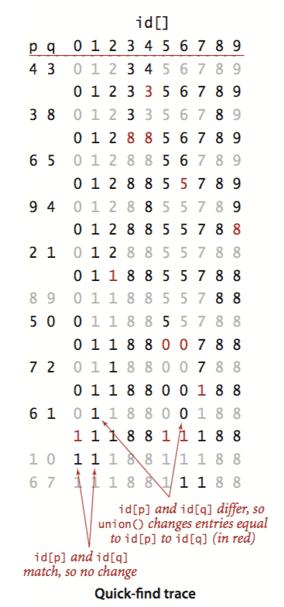
Quick-find demo
union(4, 3)
0
1
2
3
4
5
6
7
8
9
0
1
2
3
4
5
6
7
8
9
0
1
2
3
4
id[]
3
5
6
7
8
9

Slide 16
Quick-find demo
union(3, 8)
0
1
2
3
4
5
6
7
8
9
0
1
2
3
4
5
6
7
8
9
0
1
2
3
8
3
id[]
8
5
6
7
8
9

Slide 17
Quick-find demo
union(6, 5)
0
1
2
3
4
5
6
7
8
9
0
1
2
3
4
5
6
7
8
9
0
1
2
8
8
5
6
id[]
5
7
8
9

Slide 18
Quick-find demo
union(9, 4)
0
1
2
3
4
5
6
7
8
9
0
1
2
3
4
5
6
7
8
9
0
1
2
8
8
5
5
7
8
9
id[]
8

Slide 19
Quick-find demo
union(2, 1)
0
1
2
3
4
5
6
7
8
9
0
1
2
3
4
5
6
7
8
9
0
1
2
id[]
1
8
8
5
5
7
8
8

Slide 20
Quick-find demo
connected(8, 9)
0
1
2
3
4
5
6
7
8
9
0
1
2
3
4
5
6
7
8
9
id[]
0
1
1
8
8
5
5
7
8
8
already connected

Slide 21
Quick-find demo
connected(5, 0)
0
1
2
3
4
5
6
7
8
9
0
1
2
3
4
5
6
7
8
9
id[]
0
1
1
8
8
5
5
7
8
8
not connected

Slide 22
Quick-find demo
union(5, 0)
0
1
2
3
4
5
6
7
8
9
0
1
2
3
4
5
6
7
8
9
0
1
1
8
8
5
0
5
id[]
0
7
8
8

Slide 23
Quick-find demo
union(7, 2)
0
1
2
3
4
5
6
7
8
9
0
1
2
3
4
5
6
7
8
9
0
1
1
8
8
0
0
7
id[]
1
8
8

Slide 24
Quick-find demo
union(6, 1)
0
1
2
3
4
5
6
7
8
9
0
1
2
3
4
5
6
7
8
9
0
1
1
1
8
8
0
1
0
id[]
1
1
8
8

Slide 25
Quick-find demo
0
1
2
3
4
5
6
7
8
9
0
1
2
3
4
5
6
7
8
9
id[]
1
1
1
8
8
1
1
1
8
8

Slide 26
Quick-find [eager approach]
Data structure.
Integer array id[] of length N.
Interpretation: id[p] is the id of the component containing p.
if and only if
0
1
2
3
4
5
6
7
8
9
0, 5 and 6 are connected
1, 2, and 7 are connected 3, 4, 8, and 9 are connected
id[]
0
1
1
8
8
0
0
1
8
8
0
1
2
3
4
5
6
7
8
9

Slide 27
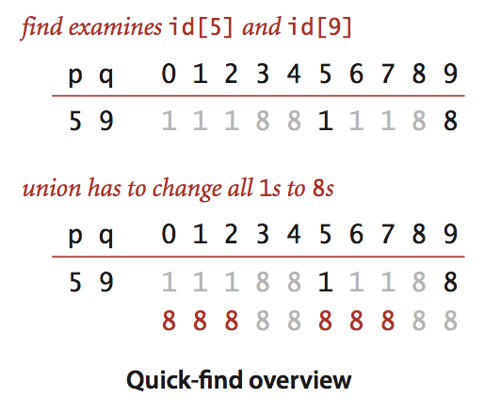
Quick-find [eager approach]
Data structure.
Integer array id[] of length N.
Interpretation: id[p] is the id of the component containing p.
* Find. What is the id of p? * Connected. Do p and q have the same id?
0
1
2
3
4
5
6
7
8
9
id[]
0
1
1
8
8
0
0
1
8
8
id[6] = 0; id[1] = 1 6 and 1 are not connected
* Union. To merge components containing p and q, change all entries whose id equals id[p] to id[q].
union (6, 1)
0
1
2
3
4
5
6
7
8
9
id[]
1
1
1
8
8
1
1
1
8
8
after union of 6 and 1
Notes:
find is fast because you just look up two array entries
challenge is updating data structure to maintain this property
Note: could also update all entries with id[q] to id[p]

Slide 28
Quick-find is too slow
Cost model. Number of array accesses (for read or write).
Union is too expensive. It takes N ² array accesses to process a sequence of N union operations on N objects.
algorithm | initialize | union | find | connected
quick-find | N | N | 1 | 1
order of growth of number of array accesses
quadratic
Notes:
this is order-of-growth of number of array accesses - we discard constants

Slide 29
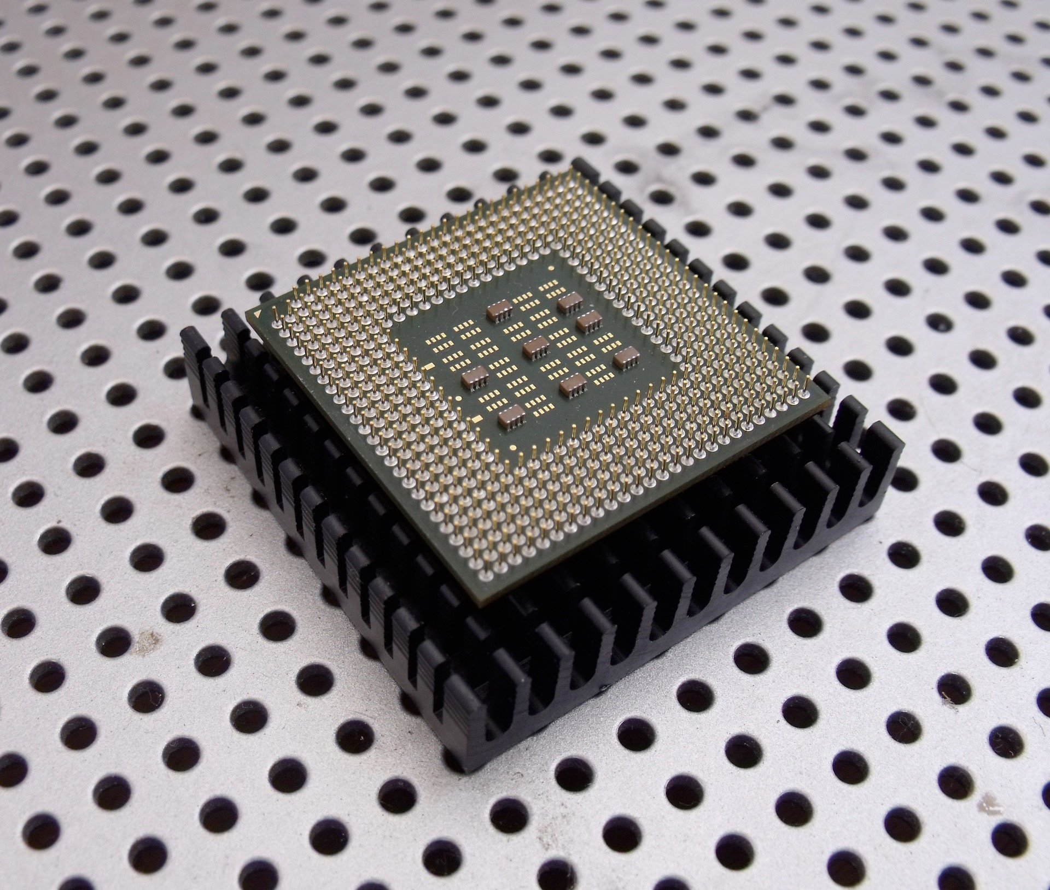
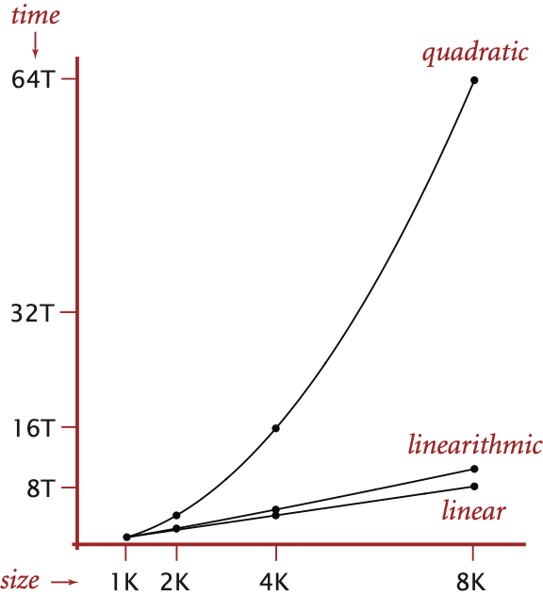
Quadratic algorithms do not scale but even worse
Rough standard (for now).
10⁹ operations per second.
10⁹ words of main memory.
Touch all words in approximately 1 second.
Ex. Huge problem for quick-find.
10⁹ union commands on 10⁹ objects.
Quick-find takes more than 10¹⁸ operations.
30+ years of computer time!
Quadratic algorithms don't scale with technology.
New computer may be 10x as fast.
But, has 10x as much memory ⇒ want to solve a problem that is 10x as big.
With quadratic algorithm, takes 10x as long!
Notes:
http://www.publicdomainpictures.net/view-image.php?image=18630&picture=computer-chip
edges may not fit in main memory
Note: number of union commands is at most 10^9; each union operation takes 10^9 steps.
Technology improves things by a constant factor. [Moore's law]
But might be costly.
Good algorithmic design can do much better and might be cheap.
Supercomputers cannot rescue a bad algorithm.

Slide 30
The Goal of This Course…
Steps to developing a usable algorithm.
Model the problem.
Find an algorithm to solve it.
Fast enough? Fits in memory?
If not, figure out why not.
Find a way to address the problem.
Iterate until satisfied.

Slide 31


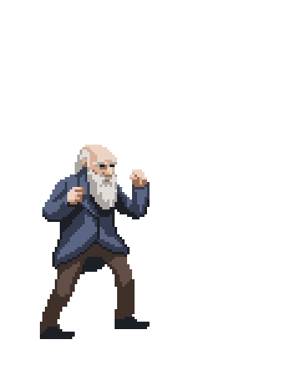

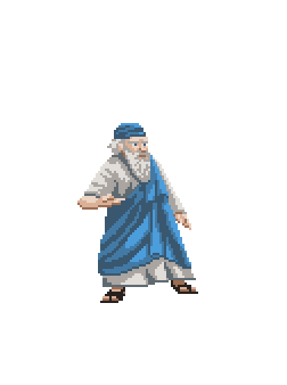


Take a Rest

Slide 32
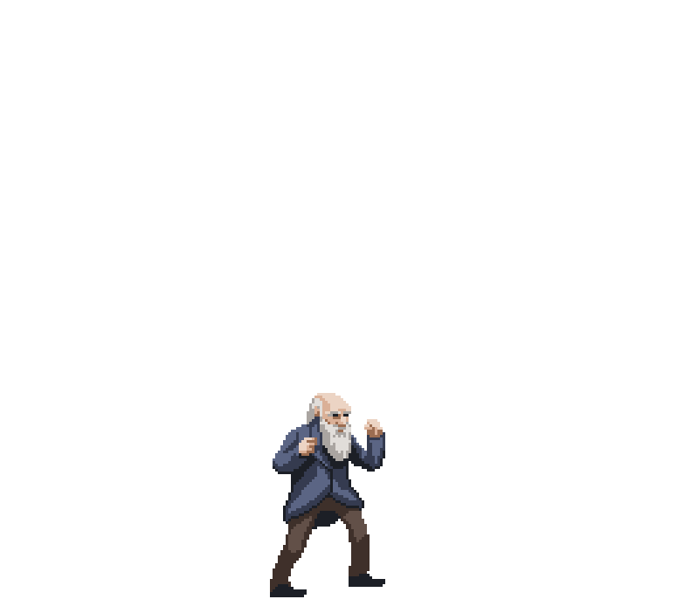

Take a Rest
Natural Selection
Evolution

Slide 33
Union-Find Problem
dynamic connectivity
quick find
quick union
improvements

Slide 34
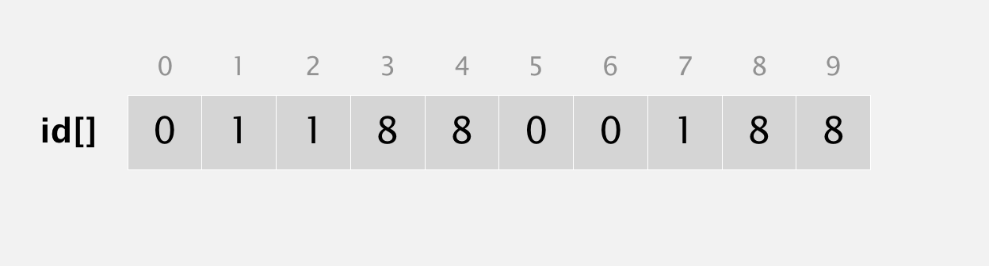
What is the problem with Quick-Find?
public void union(int p, int q) { int pid = id[p]; int qid = id[q]; for (int i = 0; i < id.length; i++) if (id[i] == pid) id[i] = qid; }
union(6, 1)
0
1
2
3
4
5
6
7
8
9
id[]
1
1
1
8
8
1
1
1
8
8
Problem: many values can change

Slide 35
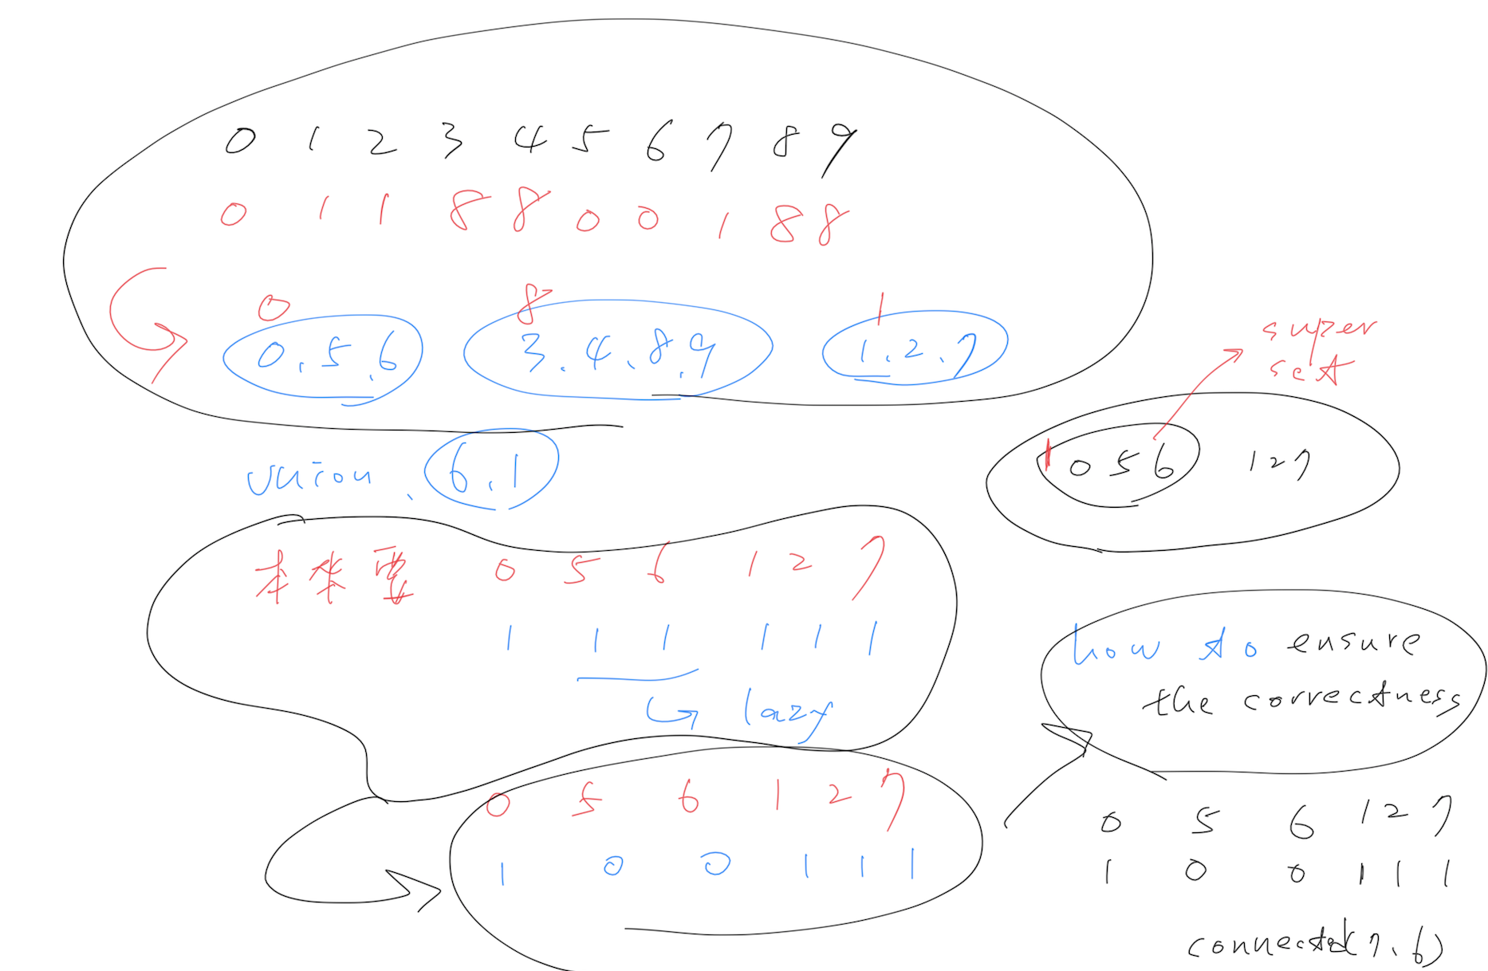

Slide 36
Quick-union [lazy approach]
Data structure.
Integer array id[] of length N.
Interpretation: id[i] is parent of i.
0
1
2
3
4
5
6
7
8
9
id[]
0
1
9
4
9
6
6
7
8
9
Notes:
3s parent is 4, 4s parent is 9
could use parent pointer/reference instead of id[] array, but array easier if objects are 0..N-1
have to change only one array entry to execute union, but price you pay is traveling up tree to find roots.

Slide 37
Quick-union [lazy approach]
Data structure.
Integer array id[] of length N.
Interpretation: id[i] is parent of i.
Root of i is id[id[id[...id[i]...]]].
keep going until it doesn’t change
(algorithm ensures no cycles)
0
1
9
6
7
8
0
1
2
3
4
5
6
7
8
9
id[]
0
1
9
4
9
6
6
7
8
9
2
4
5
3
parent of 3 is 4
root of 3 is 9
Notes:
3s parent is 4, 4s parent is 9
could use parent pointer/reference instead of id[] array, but array easier if objects are 0..N-1
have to change only one array entry to execute union, but price you pay is traveling up tree to find roots.

Slide 38
Quick-union [lazy approach]
Data structure.
Integer array id[] of length N.
Interpretation: id[i] is parent of i.
Root of i is id[id[id[...id[i]...]]].
Find. What is the root of p?
Connected. Do p and q have the same root?
Union. To merge components containing p and q, set the id of p's root to the id of q's root.
0
1
9
6
7
8
0
1
2
3
4
5
6
7
8
9
id[]
0
1
9
4
9
6
6
7
8
9
2
4
5
q
p
3
root of 3 is 9
root of 5 is 6 3 and 5 are not connected
0
1
6
7
8
9
0
1
2
3
4
5
6
7
8
9
5
q
0
1
9
4
9
6
6
7
8
6
2
4
id[]
3
only one value changes
p
Notes:
3s parent is 4, 4s parent is 9
could use parent pointer/reference instead of id[] array, but array easier if objects are 0..N-1
have to change only one array entry to execute union, but price you pay is traveling up tree to find roots.

Slide 39
Quick-union: Java implementation
public class QuickUnionUF { private int[] id;
public QuickUnionUF(int N)
{
id = new int[N];
for (int i = 0; i < N; i++) id[i] = i;
}
public int find(int i) {
while (i != id[i]) i = id[i]; return i;
}
public void union(int p, int q)
{
int proot = find(p); int qroot = find(q); id[proot] = qroot;
} }
set id of each object to itself (N array accesses)
chase parent pointers until reach root
(depth of i array accesses)
change root of p to point to root of q
(depth of p and q array accesses)

Slide 40
Quick-union demo
0
1
2
3
4
5
6
7
8
9
0
1
2
3
4
5
6
7
8
9
id[]
0
1
2
3
4
5
6
7
8
9

Slide 41
Quick-union demo
union(4, 3)
0
1
2
3
4
5
6
7
8
9
0
1
2
3
4
5
6
7
8
9
id[]
0
1
2
3
4
5
6
7
8
9

Slide 42
Quick-union demo
union(4, 3)
0
1
2
3
5
6
7
8
9
4
0
1
2
3
4
5
6
7
8
9
id[]
0
1
2
3
3
5
6
7
8
9

Slide 43
Quick-union demo
0
1
2
3
5
6
7
8
9
4
0
1
2
3
4
5
6
7
8
9
id[]
0
1
2
3
3
5
6
7
8
9

Slide 44
Quick-union demo
union(3, 8)
0
1
2
3
5
6
7
8
9
4
0
1
2
3
4
5
6
7
8
9
id[]
0
1
2
3
3
5
6
7
8
9

Slide 45
Quick-union demo
union(3, 8)
0
1
2
5
6
7
8
9
3
4
0
1
2
3
4
5
6
7
8
9
id[]
0
1
2
8
3
5
6
7
8
9

Slide 46
Quick-union demo
0
1
2
5
6
7
8
9
3
4
0
1
2
3
4
5
6
7
8
9
id[]
0
1
2
8
3
5
6
7
8
9

Slide 47
Quick-union demo
union(6, 5)
0
1
2
5
6
7
8
9
3
4
0
1
2
3
4
5
6
7
8
9
id[]
0
1
2
8
3
5
6
7
8
9

Slide 48
Quick-union demo
union(6, 5)
0
1
2
5
7
8
9
6
3
4
0
1
2
3
4
5
6
7
8
9
id[]
0
1
2
8
3
5
5
7
8
9

Slide 49
Quick-union demo
0
1
2
5
7
8
9
6
3
4
0
1
2
3
4
5
6
7
8
9
id[]
0
1
2
8
3
5
5
7
8
9

Slide 50
Quick-union demo
union(9, 4)
0
1
2
5
7
8
9
6
3
4
0
1
2
3
4
5
6
7
8
9
id[]
0
1
2
8
3
5
5
7
8
9

Slide 51
Quick-union demo
union(9, 4)
0
1
2
5
7
8
6
3
9
4
0
1
2
3
4
5
6
7
8
9
id[]
0
1
2
8
3
5
5
7
8
8

Slide 52
Quick-union demo
0
1
2
5
7
8
6
3
9
4
0
1
2
3
4
5
6
7
8
9
id[]
0
1
2
8
3
5
5
7
8
8

Slide 53
Quick-union demo
union(2, 1)
0
1
2
5
7
8
6
3
9
4
0
1
2
3
4
5
6
7
8
9
id[]
0
1
2
8
3
5
5
7
8
8

Slide 54
Quick-union demo
union(2, 1)
0
1
5
7
8
2
6
3
9
4
0
1
2
3
4
5
6
7
8
9
id[]
0
1
1
8
3
5
5
7
8
8

Slide 55
Quick-union demo
0
1
5
7
8
2
6
3
9
4
0
1
2
3
4
5
6
7
8
9
id[]
0
1
1
8
3
5
5
7
8
8

Slide 56
Quick-union demo
connected(8, 9)
✔
0
1
5
7
8
2
6
3
9
4
0
1
2
3
4
5
6
7
8
9
id[]
0
1
1
8
3
5
5
7
8
8

Slide 57
Quick-union demo
𐄂
connected(5, 4)
0
1
5
7
8
2
6
3
9
4
0
1
2
3
4
5
6
7
8
9
id[]
0
1
1
8
3
5
5
7
8
8

Slide 58
Quick-union demo
union(5, 0)
0
1
5
7
8
2
6
3
9
4
0
1
2
3
4
5
6
7
8
9
id[]
0
1
1
8
3
5
5
7
8
8

Slide 59
Quick-union demo
union(5, 0)
0
1
7
8
5
2
3
9
6
4
0
1
2
3
4
5
6
7
8
9
id[]
0
1
1
8
3
0
5
7
8
8

Slide 60
Quick-union demo
0
1
7
8
5
2
3
9
6
4
0
1
2
3
4
5
6
7
8
9
id[]
0
1
1
8
3
0
5
7
8
8

Slide 61
Quick-union demo
union(7, 2)
0
1
7
8
5
2
3
9
6
4
0
1
2
3
4
5
6
7
8
9
id[]
0
1
1
8
3
0
5
7
8
8

Slide 62
Quick-union demo
union(7, 2)
0
1
8
5
2
7
3
9
6
4
0
1
2
3
4
5
6
7
8
9
id[]
0
1
1
8
3
0
5
1
8
8

Slide 63
Quick-union demo
0
1
8
5
2
7
3
9
6
4
0
1
2
3
4
5
6
7
8
9
id[]
0
1
1
8
3
0
5
1
8
8

Slide 64
Quick-union demo
union(6, 1)
0
1
8
5
2
7
3
9
6
4
0
1
2
3
4
5
6
7
8
9
id[]
0
1
1
8
3
0
5
1
8
8

Slide 65
Quick-union demo
union(6, 1)
1
8
0
2
7
3
9
5
4
6
0
1
2
3
4
5
6
7
8
9
id[]
1
1
1
8
3
0
5
1
8
8

Slide 66
Quick-union demo
1
8
0
2
7
3
9
5
4
6
0
1
2
3
4
5
6
7
8
9
id[]
1
1
1
8
3
0
5
1
8
8

Slide 67
Quick-union demo
connected(1, 0)
1
8
0
2
7
3
9
5
4
6
0
1
2
3
4
5
6
7
8
9
id[]
1
1
1
8
3
0
5
1
8
8

Slide 68
Quick-union demo
connected(6, 7)
1
8
0
2
7
3
9
5
4
6
0
1
2
3
4
5
6
7
8
9
id[]
1
1
1
8
3
0
5
1
8
8

Slide 69
Quick-union demo
union(7, 3)
1
8
0
2
7
3
9
5
4
6
0
1
2
3
4
5
6
7
8
9
id[]
1
1
1
8
3
0
5
1
8
8

Slide 70
Quick-union demo
union(7, 3)
8
1
3
9
0
2
7
4
5
0
1
2
3
4
5
6
7
8
9
6
id[]
1
8
1
8
3
0
5
1
8
8

Slide 71
Quick-union demo
8
1
3
9
0
2
7
4
5
0
1
2
3
4
5
6
7
8
9
6
id[]
1
8
1
8
3
0
5
1
8
8

Slide 72
Quick-union: Java implementation
public class QuickUnionUF { private int[] id;
public QuickUnionUF(int N)
{
id = new int[N];
for (int i = 0; i < N; i++) id[i] = i;
}
public int find(int i) {
while (i != id[i]) i = id[i]; return i;
}
public void union(int p, int q)
{
int proot = find(p); int qroot = find(q); id[proot] = qroot;
} }
set id of each object to itself (N array accesses)
chase parent pointers until reach root
(depth of i array accesses)
change root of p to point to root of q
(depth of p and q array accesses)

Slide 73
隨堂小考1:
public class QuickUnionUF { private int[] id;
public QuickUnionUF(int N)
{
id = new int[N];
for (int i = 0; i < N; i++) id[i] = i;
}
public int find(int i) {
while (i != id[i]) i = id[i]; return i;
}
public void union(int p, int q)
{
id[p] = q;
} }
請實際trace一遍
改成這樣，發生什麼事，有什麼優缺點？

Slide 74
Code Comparison
public class QuickFindUF { private int[] id;
public QuickFindUF(int N)
{
id = new int[N]; for (int i = 0; i < N; i++) id[i] = i;
}
public int find(int p) { return id[p]; }
public void union(int p, int q) { int pid = id[p]; int qid = id[q]; for (int i = 0; i < id.length; i++) if (id[i] == pid) id[i] = qid; }
}
public class QuickUnionUF { private int[] id;
public QuickUnionUF(int N)
{
id = new int[N];
for (int i = 0; i < N; i++) id[i] = i;
}
public int find(int i) {
while (i != id[i]) i = id[i]; return i;
}
public void union(int p, int q)
{
int proot = find(p); int qroot = find(q); id[proot] = qroot;
} }

Slide 75
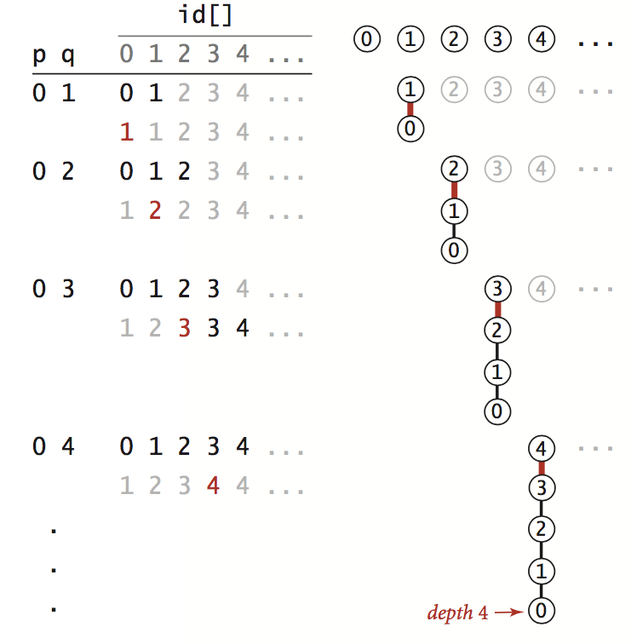
QuickUnion is the solution ? ( 01 12 23 34)
algorithm | initialize | union | find | connected
quick-find | N | N | 1 | 1
quick-union | N | Tree Height | Tree Height | Tree Height
想想看：
Please give an example to show the worst case of the quick union…

Slide 76
練習: 請舉一個Quick-Union最好的case
algorithm | initialize | union | find | connected
quick-find | N | N | 1 | 1
quick-union | N | Tree Height | Tree Height | Tree Height
Please give an example to show the best case of the quick union…

Slide 77
Quick-union is also too slow
Cost model. Number of array accesses (for read or write).
Quick-find defect.
Union too expensive (N array accesses).
Trees are flat, but too expensive to keep them flat.
Quick-union defect.
Trees can get tall.
Find/connected too expensive (could be N array accesses).
algorithm | initialize | union | find | connected
quick-find | N | N | 1 | 1
quick-union | N | N † | N | N
worst case
† includes cost of finding roots

Slide 78
Union-Find Problem
dynamic connectivity
quick find
quick union
weighted quick union
applications

Slide 79
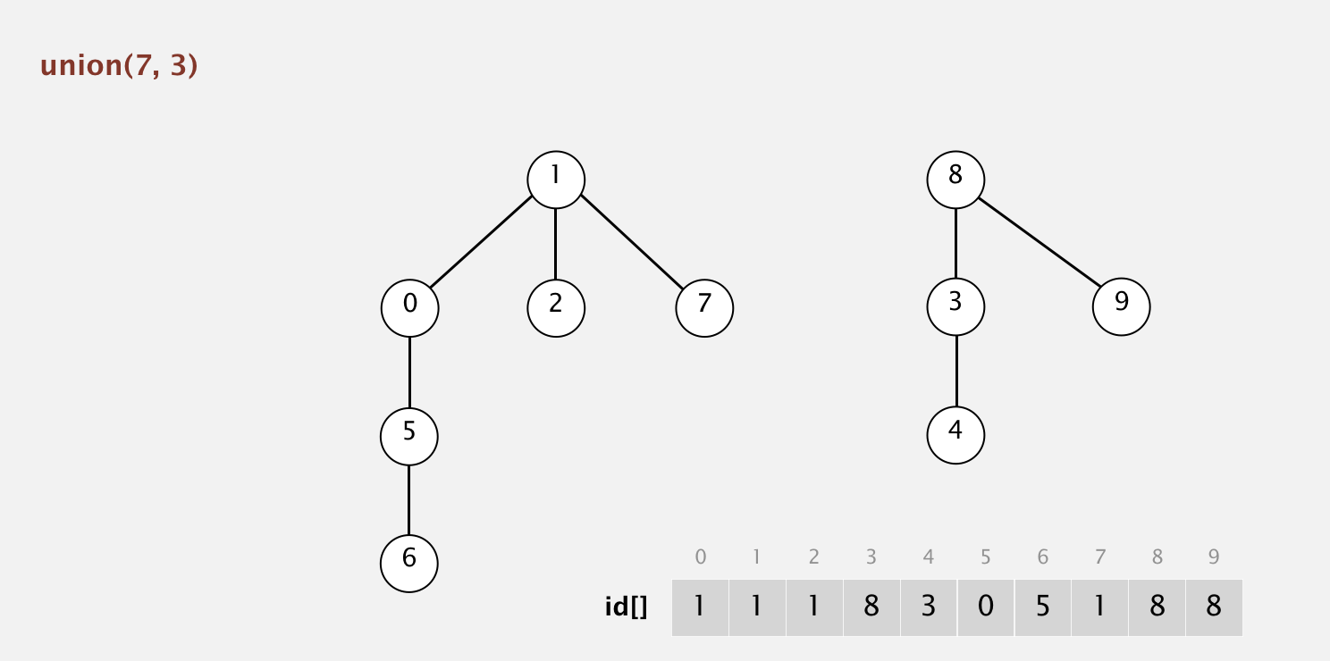
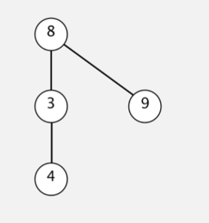
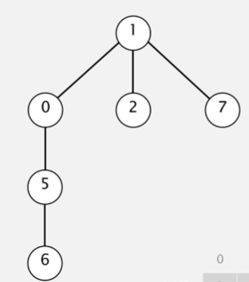
Where is the problem ??

Slide 80
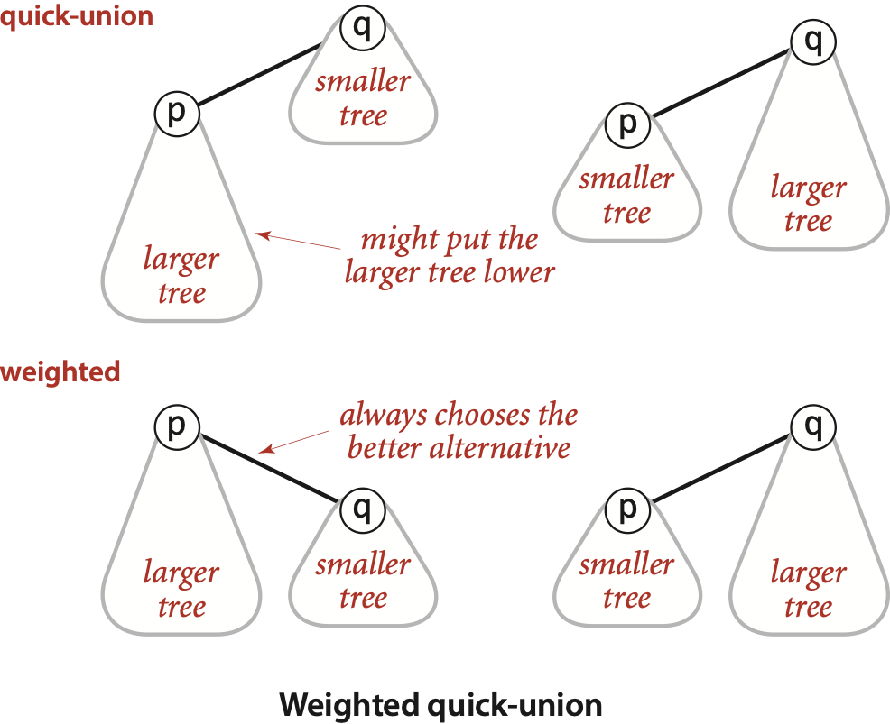
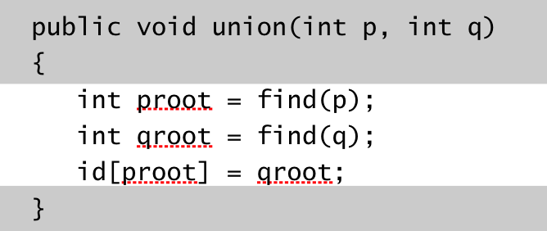
Improvement 1: weighting
Weighted quick-union.
Modify quick-union to avoid tall trees.
Keep track of size of each tree (number of objects).
Balance by linking root of smaller tree to root of larger tree.
Notes:
alternatively, could use union-by-height or union-by-rank (variant of height that is easy to maintain even when using path compression)
we use height since it's easier to implement than union-by-height and and more intuitive than union-by-rank.
all lead to stated performance guarantees

Slide 81
Weighted quick-union: Java implementation
Data structure. Same as quick-union, but maintain extra array sz[i] to count number of objects in the tree rooted at i.
Find/connected. Identical to quick-union.
Union. Modify quick-union to:
Link root of smaller tree to root of larger tree.
Update the sz[] array.
int proot = find(p);
int qroot = find(q);
if (sz[proot] < sz[qroot]) {
id[proot] = qroot;
sz[qroot] += sz[proot]; }
else {
id[qroot] = proot;
sz[proot] += sz[qroot]; }

Slide 82
Weighted quick-union demo
union(4, 3)
0
1
2
3
4
5
6
7
8
9
0
1
2
3
4
5
6
7
8
9
id[]
0
1
2
3
4
5
6
7
8
9

Slide 83
Weighted quick-union demo
union(4, 3)
0
1
2
4
5
6
7
8
9
3
0
1
2
3
4
5
6
7
8
9
id[]
0
1
2
4
4
5
6
7
8
9

Slide 84
Weighted quick-union demo
0
1
2
4
5
6
7
8
9
3
0
1
2
3
4
5
6
7
8
9
id[]
0
1
2
4
4
5
6
7
8
9

Slide 85
Weighted quick-union demo
union(3, 8)
0
1
2
4
5
6
7
8
9
3
0
1
2
3
4
5
6
7
8
9
id[]
0
1
2
4
4
5
6
7
8
9

Slide 86
Weighted quick-union demo
weighting: make 8 point to 4 (instead of 4 to 8)
union(3, 8)
0
1
2
4
5
6
7
9
3
8
0
1
2
3
4
5
6
7
8
9
id[]
0
1
2
4
4
5
6
7
4
9

Slide 87
Weighted quick-union demo
0
1
2
4
5
6
7
9
3
8
0
1
2
3
4
5
6
7
8
9
id[]
0
1
2
4
4
5
6
7
4
9

Slide 88
Weighted quick-union demo
union(6, 5)
0
1
2
4
5
6
7
9
3
8
0
1
2
3
4
5
6
7
8
9
id[]
0
1
2
4
4
5
6
7
4
9

Slide 89
Weighted quick-union demo
union(6, 5)
0
1
2
4
6
7
9
3
8
5
0
1
2
3
4
5
6
7
8
9
id[]
0
1
2
4
4
6
6
7
4
9

Slide 90
Weighted quick-union demo
0
1
2
4
6
7
9
3
8
5
0
1
2
3
4
5
6
7
8
9
id[]
0
1
2
4
4
6
6
7
4
9

Slide 91
Weighted quick-union demo
union(9, 4)
0
1
2
4
6
7
9
3
8
5
0
1
2
3
4
5
6
7
8
9
id[]
0
1
2
4
4
6
6
7
4
9

Slide 92
Weighted quick-union demo
weighting: make 9 point to 4
union(9, 4)
0
1
2
4
6
7
3
8
9
5
0
1
2
3
4
5
6
7
8
9
id[]
0
1
2
4
4
6
6
7
4
4

Slide 93
Weighted quick-union demo
0
1
2
4
6
7
3
8
9
5
0
1
2
3
4
5
6
7
8
9
id[]
0
1
2
4
4
6
6
7
4
4

Slide 94
Weighted quick-union demo
union(2, 1)
0
1
2
4
6
7
3
8
9
5
0
1
2
3
4
5
6
7
8
9
id[]
0
1
2
4
4
6
6
7
4
4

Slide 95
Weighted quick-union demo
union(2, 1)
0
2
4
6
7
1
3
8
9
5
0
1
2
3
4
5
6
7
8
9
id[]
0
2
2
4
4
6
6
7
4
4

Slide 96
Weighted quick-union demo
0
2
4
6
7
1
3
8
9
5
0
1
2
3
4
5
6
7
8
9
id[]
0
2
2
4
4
6
6
7
4
4

Slide 97
Weighted quick-union demo
union(5, 0)
0
2
4
6
7
1
3
8
9
5
0
1
2
3
4
5
6
7
8
9
id[]
0
2
2
4
4
6
6
7
4
4

Slide 98
Weighted quick-union demo
weighting: make 0 point to 6 (instead of 6 to 0)
union(5, 0)
2
4
6
7
1
3
8
9
0
5
0
1
2
3
4
5
6
7
8
9
id[]
6
2
2
4
4
6
6
7
4
4

Slide 99
Weighted quick-union demo
2
4
6
7
1
3
8
9
0
5
0
1
2
3
4
5
6
7
8
9
id[]
6
2
2
4
4
6
6
7
4
4

Slide 100
Weighted quick-union demo
union(7, 2)
2
4
6
7
1
3
8
9
0
5
0
1
2
3
4
5
6
7
8
9
id[]
6
2
2
4
4
6
6
7
4
4

Slide 101
Weighted quick-union demo
weighting: make 7 point to 2
union(7, 2)
2
4
6
1
7
3
8
9
0
5
0
1
2
3
4
5
6
7
8
9
id[]
6
2
2
4
4
6
6
2
4
4

Slide 102
Weighted quick-union demo
2
4
6
1
7
3
8
9
0
5
0
1
2
3
4
5
6
7
8
9
id[]
6
2
2
4
4
6
6
2
4
4

Slide 103
Weighted quick-union demo
union(6, 1)
2
4
6
1
7
3
8
9
0
5
0
1
2
3
4
5
6
7
8
9
id[]
6
2
2
4
4
6
6
2
4
4

Slide 104
Weighted quick-union demo
union(6, 1)
4
6
3
8
9
0
2
5
1
7
0
1
2
3
4
5
6
7
8
9
id[]
6
2
6
4
4
6
6
2
4
4

Slide 105
Weighted quick-union demo
4
6
3
8
9
0
2
5
1
7
0
1
2
3
4
5
6
7
8
9
id[]
6
2
6
4
4
6
6
2
4
4

Slide 106
Weighted quick-union demo
union(7, 3)
4
6
3
8
9
0
2
5
1
7
0
1
2
3
4
5
6
7
8
9
id[]
6
2
6
4
4
6
6
2
4
4
Notes:
weighting makes 4 point to 6 (instead of 6 point to 4)

Slide 107
Weighted quick-union demo
weighting: make 4 point to 6 (instead of 6 to 4)
union(7, 3)
6
4
0
2
5
3
8
9
1
7
0
1
2
3
4
5
6
7
8
9
id[]
6
2
6
4
6
6
6
2
4
4

Slide 108
Weighted quick-union demo
6
4
0
2
5
3
8
9
1
7
0
1
2
3
4
5
6
7
8
9
id[]
6
2
6
4
6
6
6
2
4
4

Slide 109
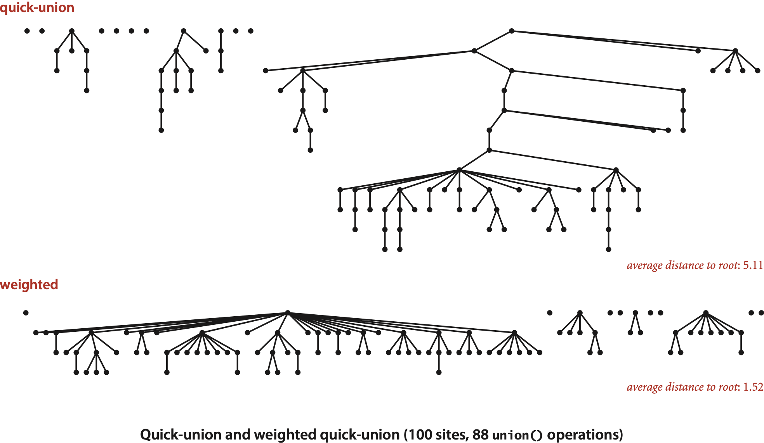
Quick-union and weighted quick-union example

Slide 110
Weighted quick-union analysis
Running time.
Find: takes time proportional to depth of p.
Union: takes constant time, given roots.
Proposition. Depth of any node x is at most lg N.
lg = base-2 logarithm
0
1
1
1
2
2
2
2
x
depth 3
3
3
N = 11
depth(x) = 3 ≤ lg N

Slide 111
Weighted quick-union analysis
Running time.
Find: takes time proportional to depth of p.
Union: takes constant time, given roots.
Proposition. Depth of any node x is at most lg N.
Pf. What causes the depth of object x to increase?
Increases by 1 when tree T1 containing x is merged into another tree T2.
The size of the tree containing x at least doubles since | T 2 | ≥ | T 1 |.
Size of tree containing x can double at most lg N times. Why?
lg = base-2 logarithm
1
2
4
8
16
⋮
N
T2
T1
lg N
x
Notes:
since we are merging by size, size(T2) >= size(T1)
could also merge by height or rank, as done in some textbooks, but union by size achieves same amortized complexity
merging by rank has the slight advantage that the number of bits needed to encode the rank is logarithmically less than that needed to encode the size

Slide 112
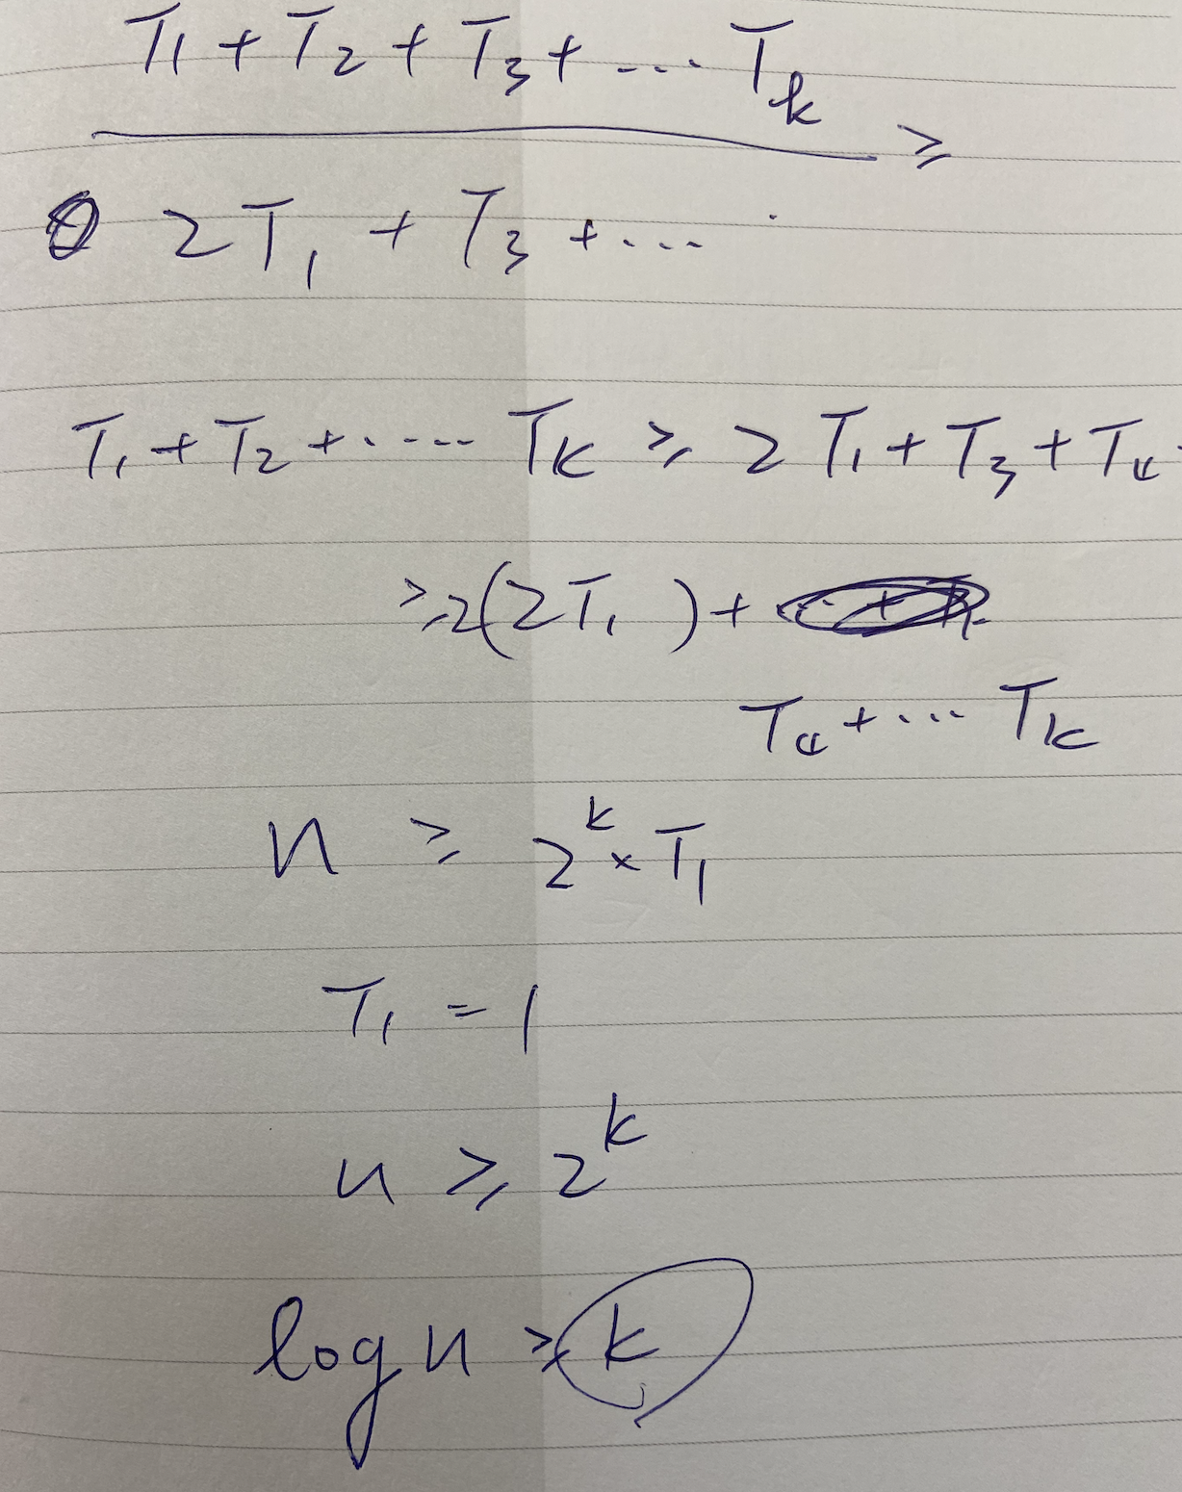

Slide 113
Weighted quick-union analysis
Running time.
Find: takes time proportional to depth of p.
Union: takes constant time, given roots.
Proposition. Depth of any node x is at most lg N.
Q. Stop at guaranteed acceptable performance?
A. No, easy to improve further.
algorithm | initialize | union | find | connected
quick-find | N | N | 1 | 1
quick-union | N | N † | N | N
weighted QU | N | lg N † | lg N | lg N
† includes cost of finding roots
Notes:
Q. Can you think of a function that grows slower than log N (but that is not constant)?
A. Common answers: log log N, log log log N

Slide 114
作業1：想想看，如果利用高度(height)決定誰為 root，會比較好還是比較差。
Weighted quick-union.
Modify quick-union to avoid tall trees.
Keep track of size of each tree (number of objects).
Balance by linking root of smaller tree to root of larger tree.
reasonable alternatives:
union by height or "rank"
Notes:
alternatively, could use union-by-height or union-by-rank (variant of height that is easy to maintain even when using path compression)
we use height since it's easier to implement than union-by-height and and more intuitive than union-by-rank.
all lead to stated performance guarantees

Slide 115
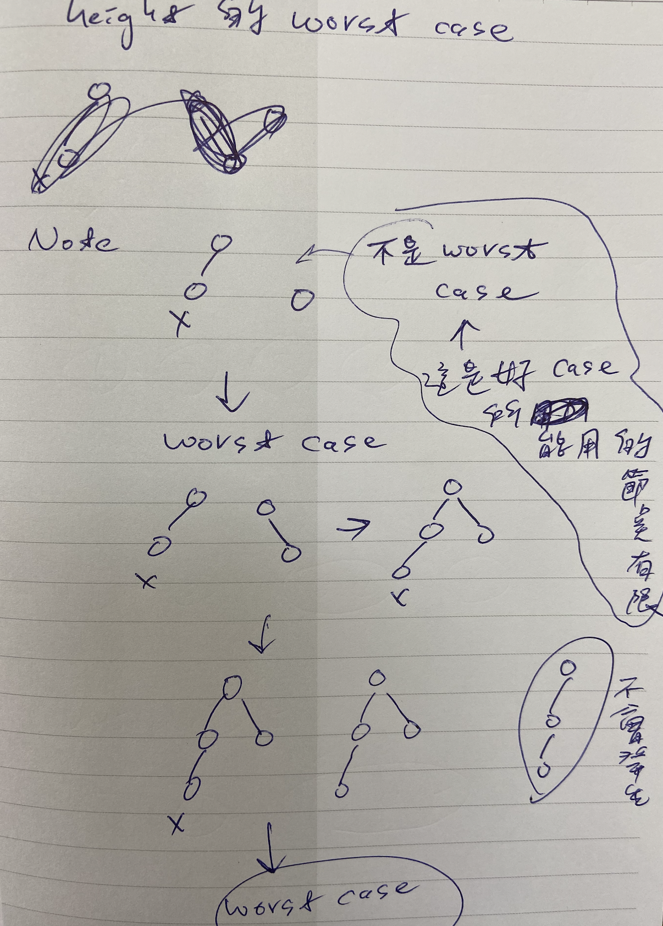
weight proof

Slide 116


Rest
E=mc2
Relativity

Slide 117
Any Other Possible Way to Speed Up ?
Ideally, we would like every node to link directly to the root of its tree, but we do not want to pay the price of changing a large number of links, as we did in the quick-find algorithm.
We can approach the idea simply by making all the nodes that we do examine directly link to the root.
only one extra line of code !
public int find(int i) {
while (i != id[i])
i = id[i];
return i;
}
public int find(int i) { while (i != id[i]) {
id[i] = id[id[i]];
i = id[i];
}
return i; }

Slide 118
Path compression: Java implementation
Two-pass implementation: add second loop to find() to set the id[] of each examined node to the root.
Simpler one-pass variant (path halving): Make every other node in path point to its grandparent.
In practice. No reason not to! Keeps tree almost completely flat.
public int find(int i) { while (i != id[i]) {
id[i] = id[id[i]];
i = id[i];
}
return i; }
only one extra line of code !

Slide 119
Weighted quick-union with path compression demo
0
1
2
3
4
5
6
7
8
9
0
1
2
3
4
5
6
7
8
9
id[]
0
1
2
3
4
5
6
7
8
9

Slide 120
Weighted quick-union with path compression demo
union(4, 3)
0
1
2
3
4
5
6
7
8
9
0
1
2
3
4
5
6
7
8
9
id[]
0
1
2
3
4
5
6
7
8
9

Slide 121
Weighted quick-union with path compression demo
union(4, 3)
0
1
2
4
5
6
7
8
9
3
0
1
2
3
4
5
6
7
8
9
id[]
0
1
2
4
4
5
6
7
8
9

Slide 122
Weighted quick-union with path compression demo
0
1
2
4
5
6
7
8
9
3
0
1
2
3
4
5
6
7
8
9
id[]
0
1
2
4
4
5
6
7
8
9

Slide 123
Weighted quick-union with path compression demo
union(3, 8)
0
1
2
4
5
6
7
8
9
3
0
1
2
3
4
5
6
7
8
9
id[]
0
1
2
4
4
5
6
7
8
9

Slide 124
Weighted quick-union with path compression demo
union(3, 8)
0
1
2
4
5
6
7
9
3
8
0
1
2
3
4
5
6
7
8
9
id[]
0
1
2
4
4
5
6
7
4
9

Slide 125
Weighted quick-union with path compression demo
0
1
2
4
5
6
7
9
3
8
0
1
2
3
4
5
6
7
8
9
id[]
0
1
2
4
4
5
6
7
4
9

Slide 126
Weighted quick-union with path compression demo
union(6, 5)
0
1
2
4
5
6
7
9
3
8
0
1
2
3
4
5
6
7
8
9
id[]
0
1
2
4
4
5
6
7
4
9

Slide 127
Weighted quick-union with path compression demo
union(6, 5)
0
1
2
4
6
7
9
3
8
5
0
1
2
3
4
5
6
7
8
9
id[]
0
1
2
4
4
6
6
7
4
9

Slide 128
Weighted quick-union with path compression demo
0
1
2
4
6
7
9
3
8
5
0
1
2
3
4
5
6
7
8
9
id[]
0
1
2
4
4
6
6
7
4
9

Slide 129
Weighted quick-union with path compression demo
union(9, 4)
0
1
2
4
6
7
9
3
8
5
0
1
2
3
4
5
6
7
8
9
id[]
0
1
2
4
4
6
6
7
4
9

Slide 130
Weighted quick-union with path compression demo
union(9, 4)
0
1
2
4
6
7
3
8
9
5
0
1
2
3
4
5
6
7
8
9
id[]
0
1
2
4
4
6
6
7
4
4

Slide 131
Weighted quick-union with path compression demo
0
1
2
4
6
7
3
8
9
5
0
1
2
3
4
5
6
7
8
9
id[]
0
1
2
4
4
6
6
7
4
4

Slide 132
Weighted quick-union with path compression demo
union(2, 1)
0
1
2
4
6
7
3
8
9
5
0
1
2
3
4
5
6
7
8
9
id[]
0
1
2
4
4
6
6
7
4
4

Slide 133
Weighted quick-union with path compression demo
union(2, 1)
0
2
4
6
7
1
3
8
9
5
0
1
2
3
4
5
6
7
8
9
id[]
0
2
2
4
4
6
6
7
4
4

Slide 134
Weighted quick-union with path compression demo
0
2
4
6
7
1
3
8
9
5
0
1
2
3
4
5
6
7
8
9
id[]
0
2
2
4
4
6
6
7
4
4

Slide 135
Weighted quick-union with path compression demo
union(5, 0)
0
2
4
6
7
1
3
8
9
5
0
1
2
3
4
5
6
7
8
9
id[]
0
2
2
4
4
6
6
7
4
4

Slide 136
Weighted quick-union with path compression demo
union(5, 0)
2
4
6
7
1
3
8
9
0
5
0
1
2
3
4
5
6
7
8
9
id[]
6
2
2
4
4
6
6
7
4
4

Slide 137
Weighted quick-union with path compression demo
2
4
6
7
1
3
8
9
0
5
0
1
2
3
4
5
6
7
8
9
id[]
6
2
2
4
4
6
6
7
4
4

Slide 138
Weighted quick-union with path compression demo
union(7, 2)
2
4
6
7
1
3
8
9
0
5
0
1
2
3
4
5
6
7
8
9
id[]
6
2
2
4
4
6
6
7
4
4

Slide 139
Weighted quick-union with path compression demo
union(7, 2)
2
4
6
1
7
3
8
9
0
5
0
1
2
3
4
5
6
7
8
9
id[]
6
2
2
4
4
6
6
2
4
4

Slide 140
Weighted quick-union with path compression demo
2
4
6
1
7
3
8
9
0
5
0
1
2
3
4
5
6
7
8
9
id[]
6
2
2
4
4
6
6
2
4
4

Slide 141
Weighted quick-union with path compression demo
union(6, 1)
2
4
6
1
7
3
8
9
0
5
0
1
2
3
4
5
6
7
8
9
id[]
6
2
2
4
4
6
6
2
4
4

Slide 142
Weighted quick-union with path compression demo
union(6, 1)
4
6
3
8
9
0
2
5
1
7
0
1
2
3
4
5
6
7
8
9
id[]
6
2
6
4
4
6
6
2
4
4

Slide 143
Weighted quick-union with path compression demo
4
6
3
8
9
0
2
5
1
7
0
1
2
3
4
5
6
7
8
9
id[]
6
2
6
4
4
6
6
2
4
4

Slide 144
Weighted quick-union with path compression demo
union(7, 3)
4
6
3
8
9
0
2
5
1
7
0
1
2
3
4
5
6
7
8
9
id[]
6
2
6
4
4
6
6
2
4
4

Slide 145
Weighted quick-union with path compression demo
path compression:
make 7 point to 6
union(7, 3)
4
6
3
8
9
0
2
5
7
1
0
1
2
3
4
5
6
7
8
9
id[]
6
2
6
4
4
6
6
6
4
4

Slide 146
Weighted quick-union with path compression demo
union(7, 3)
6
4
0
2
5
7
3
8
9
1
0
1
2
3
4
5
6
7
8
9
id[]
6
2
6
4
6
6
6
6
4
4

Slide 147
Weighted quick-union with path compression demo
6
4
0
2
5
7
3
8
9
1
0
1
2
3
4
5
6
7
8
9
id[]
6
2
6
4
6
6
6
6
4
4

Slide 148
Improvement 2: path compression
Quick union with path compression. Just after computing the root of p,
set the id[] of each examined node to point to that root.
0
root
1
2
3
4
5
6
7
p
8
x
9
10
11
12

Slide 149
Improvement 2: path compression
Quick union with path compression. Just after computing the root of p,
set the id[] of each examined node to point to that root.
0
root
p
9
1
2
11
12
3
4
5
x
6
7
8
10

Slide 150
Improvement 2: path compression
Quick union with path compression. Just after computing the root of p,
set the id[] of each examined node to point to that root.
0
root
p
9
6
1
2
11
12
8
x
3
4
5
10
7

Slide 151
Improvement 2: path compression
Quick union with path compression. Just after computing the root of p,
set the id[] of each examined node to point to that root.
0
root
p
9
6
3
x
1
2
11
12
8
7
4
5
10

Slide 152
Improvement 2: path compression
Quick union with path compression. Just after computing the root of p,
set the id[] of each examined node to point to that root.
Bottom line. Now, find() has the side effect of compressing the tree.
x
0
root
p
9
6
3
1
2
11
12
8
7
4
5
10

Slide 153
Weighted quick-union with path compression demo
connected(9, 1)
✔
6
4
0
2
5
7
3
8
9
1
0
1
2
3
4
5
6
7
8
9
id[]
6
2
6
4
6
6
6
6
4
4
Notes:
Note: tree can change when calling connected()

Slide 154
Weighted quick-union with path compression demo
✔
path compression:
make 9 point to 6
connected(9, 1)
6
4
9
0
2
5
7
3
8
1
0
1
2
3
4
5
6
7
8
9
id[]
6
2
6
4
6
6
6
6
4
6

Slide 155
Weighted quick-union with path compression demo
✔
path compression:
make 1 point to 6
connected(9, 1)
6
4
9
0
1
2
5
7
3
8
0
1
2
3
4
5
6
7
8
9
id[]
6
6
6
4
6
6
6
6
4
6

Slide 156
Weighted quick-union with path compression demo
6
4
9
0
1
2
5
7
3
8
0
1
2
3
4
5
6
7
8
9
id[]
6
6
6
4
6
6
6
6
4
6

Slide 157
Summary
Key point. Weighted quick union (and/or path compression) makes it possible to solve problems that could not otherwise be addressed.
Ex. [10⁹ unions and finds with 10⁹ objects]
WQUPC reduces time from 30 years to 6 seconds.
Supercomputer won't help much; good algorithm enables solution.
algorithm | worst-case time
quick-find | M N
quick-union | M N
weighted QU | N + M log N
QU + path compression | N + M log N
weighted QU + path compression | N + M lg* N
N | lg* N
1 | 0
2 | 1
4 | 2
16 | 3
65536 | 4
2⁶⁵⁵³⁶ | 5
order of growth for M union-find operations on a set of N objects
iterated lg function
Notes:
WQUPC on Java cell phone beats QF on supercomputer!
if we could do this well on every problem, we'd be in great shape! but lots of useful problems where N^2 or N^3 is easy, basic ideas in data structures hammers it to N log N or better.

Slide 158
.
Steps to developing a usable algorithm.
Model the problem.
Find an algorithm to solve it.
Fast enough? Fits in memory?
If not, figure out why.
Find a way to address the problem.
Iterate until satisfied.
The scientific method.
Mathematical analysis.

Slide 159
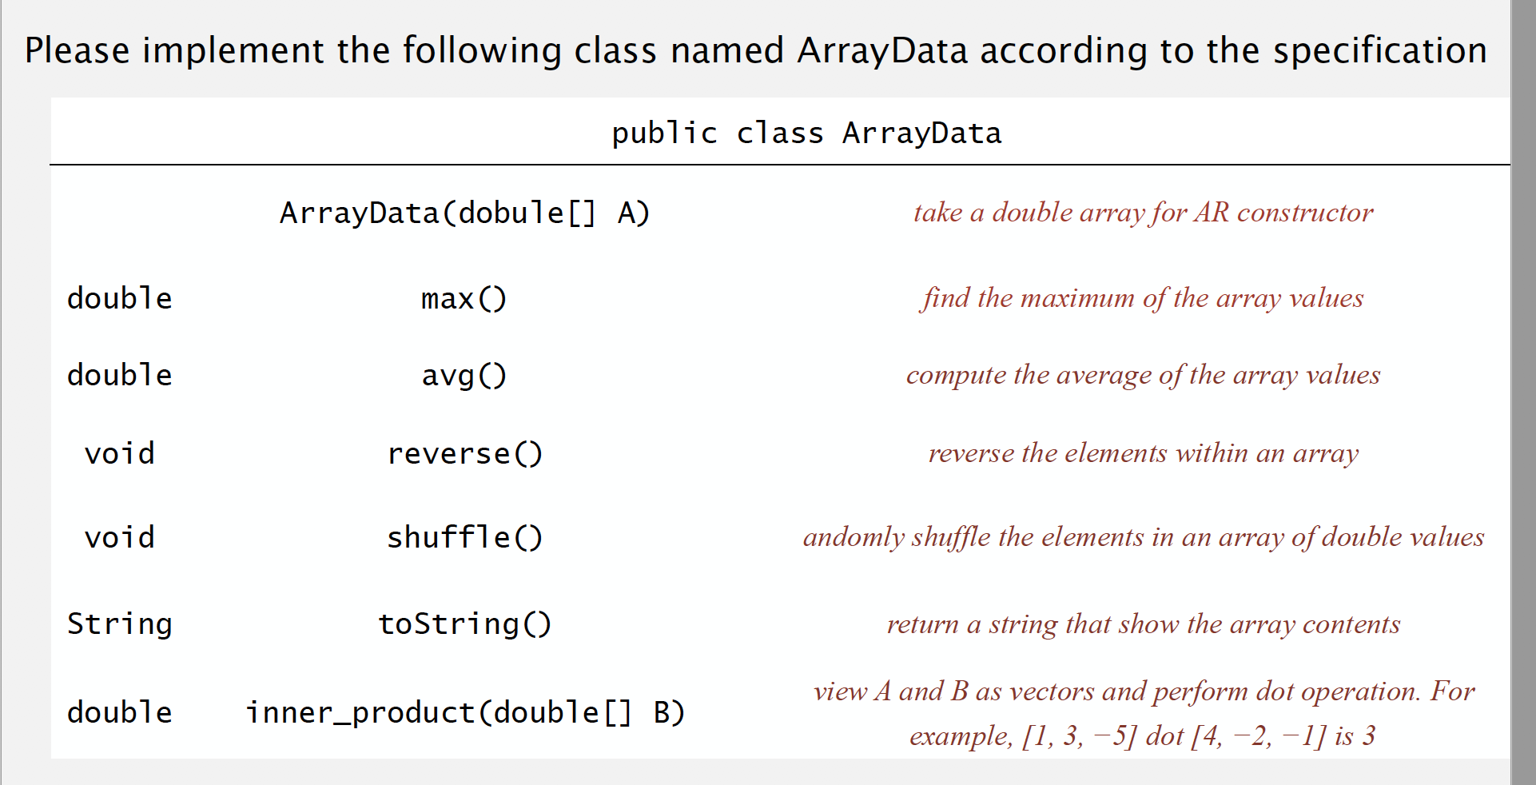
Homework Assignment #1

Slide 160
A connectivity example
Q. Is there a path connecting p and q ?
A. Yes.
p
q
Notes:
more difficult problem: find the path. We will revisit this problem in the second half of the course. But dynamic solutions that don't need to find the path are more efficient.
medium.txt (625 sites, 900 edges, 3 connected components)

Slide 161
Quick-union [lazy approach]
Data structure.
Integer array id[] of length N.
Interpretation: id[i] is parent of i.
Root of i is id[id[id[...id[i]...]]].
Find. What is the root of p?
Connected. Do p and q have the same root?
Union. To merge components containing p and q, set the id of p's root to the id of q's root.
0
1
9
6
7
8
0
1
2
3
4
5
6
7
8
9
id[]
0
1
9
4
9
6
6
7
8
9
2
4
5
q
p
3
root of 3 is 9
root of 5 is 6 3 and 5 are not connected
0
1
6
7
8
9
0
1
2
3
4
5
6
7
8
9
5
q
0
1
9
4
9
6
6
7
8
6
2
4
id[]
3
only one value changes
p
Notes:
3s parent is 4, 4s parent is 9
could use parent pointer/reference instead of id[] array, but array easier if objects are 0..N-1
have to change only one array entry to execute union, but price you pay is traveling up tree to find roots.

Slide 162
Quick-find [eager approach]
Data structure.
Integer array id[] of length N.
Interpretation: id[p] is the id of the component containing p.
* Find. What is the id of p? * Connected. Do p and q have the same id?
0
1
2
3
4
5
6
7
8
9
id[]
0
1
1
8
8
0
0
1
8
8
id[6] = 0; id[1] = 1 6 and 1 are not connected
* Union. To merge components containing p and q, change all entries whose id equals id[p] to id[q].
union (6, 1)
0
1
2
3
4
5
6
7
8
9
id[]
1
1
1
8
8
1
1
1
8
8
after union of 6 and 1
Notes:
find is fast because you just look up two array entries
challenge is updating data structure to maintain this property
Note: could also update all entries with id[q] to id[p]

Slide 163
Code Comparison
public class QuickFindUF { private int[] id;
public QuickFindUF(int N)
{
id = new int[N]; for (int i = 0; i < N; i++) id[i] = i;
}
public int find(int p) { return id[p]; }
public void union(int p, int q) { int pid = id[p]; int qid = id[q]; for (int i = 0; i < id.length; i++) if (id[i] == pid) id[i] = qid; }
}
public class QuickUnionUF { private int[] id;
public QuickUnionUF(int N)
{
id = new int[N];
for (int i = 0; i < N; i++) id[i] = i;
}
public int find(int i) {
while (i != id[i]) i = id[i]; return i;
}
public void union(int p, int q)
{
int proot = find(p); int qroot = find(q); id[proot] = qroot;
} }

Slide 164
Improvement 1: weighting
Weighted quick-union.
Modify quick-union to avoid tall trees.
Keep track of size of each tree (number of objects).
Balance by linking root of smaller tree to root of larger tree.
Notes:
alternatively, could use union-by-height or union-by-rank (variant of height that is easy to maintain even when using path compression)
we use height since it's easier to implement than union-by-height and and more intuitive than union-by-rank.
all lead to stated performance guarantees

Slide 165
Weighted quick-union analysis
Running time.
Find: takes time proportional to depth of p.
Union: takes constant time, given roots.
Proposition. Depth of any node x is at most lg N.
Q. Stop at guaranteed acceptable performance?
A. No, easy to improve further.
algorithm | initialize | union | find | connected
quick-find | N | N | 1 | 1
quick-union | N | N † | N | N
weighted QU | N | lg N † | lg N | lg N
† includes cost of finding roots
Notes:
Q. Can you think of a function that grows slower than log N (but that is not constant)?
A. Common answers: log log N, log log log N

